Slide 1
SupplyASAP
Deliver critical resources when you need them the most

Slide 2

Judy Taylor
Procurement Manager of Hospital in NYC
“I urgently need supplies to maintain my operations during pandemic.
How might I mobilize the supplies in an efficient way?”

Slide 3
Imbalance resources due to over ordering and hoarding
Florida
New York
Florida has requested double the amount of masks per infected patient vs. NYC
Florida is further back in the COVID curve and it is competing for equipment needed by NYC
Not to scale
1.8M
38x
18x
430k
100k
11k
Mask requested by state
Covid Cases in state
Mask requested by state
Covid Cases in state
Source: Vox, NY Post, Microsoft Bing
Notes:
Key message: 1/ Clear hoarding mentality, 2/ they can redeploy 50% of inventory and also reduce future requests
We compared the number of masks requested by 3 states vs the number of COVID cases. This gives us a proxy of how many masks are required per patient
As you can see Florida has requested 38 masks per infected case compared to NYC the worst affected area requesting 18 masks per case
This analysis highlights 2 points, the most affected areas cant access stock because other states are over ordering, second if the states with excess stock can reduce their levels by 50% it can 1/ reduce demand and 2/ redeploy to areas in need

Slide 4

Our vision is to reimagine the medical supply chain by creating a new exchange

Slide 5
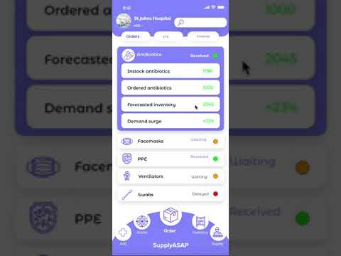




Our solution
Inventory Forecasting
P2P Marketplace
Powered by
AI Predictive Model
Process Mining
Notes:
This is updated wireframe

Slide 6




Technical Execution
Hospitals
Storage
ML
Forecast
Process Mining
Transactions
SupplyASAP
Notes:
Aws
Amazon forecast
Celonis
Stripe

Slide 7

Uniquely positioned to tackle the current market inefficiencies
SupplyASAP
Sowingo
MyMediSet
Designed for healthcare
+ crisis management
P2P Exchange
e-commerce
AI for inventory forecasting
Advanced
Low
Mid
API Integration
Notes:
Key message: 1/ SuppliesASAP is uniquely positioned to solve the current market inefficiency 2/ we will build a superior inventory management platform to continue solving healthcare pain points
We offer an end to end solution for hospitals
Unique p2p solution, tactically positioned to solve the current market inefficiencies
Build a superiod AI tool

Slide 8
Our product has the potential to positively impact the current COVID-19 situation
800k+
Up to
50%
Up to 75%
Front line medical practitioners in the US in need of protection¹
Of inventory can be Unlock and redeployment to those in need²
Reduction in delivery time, from 12 days to 3 days³
1. Statista, 2. Based on Florida vs NYC analysis, 3. Assuming no production timeline as finished goods in surplus are traded instead of being produced
Notes:
Key messages: 1/ Save lives 2/ redeploy inventory 3/ reduce time
Up to 50% of inventory can be redeployed, by reallocation from those with excess to those with less. As shown in slide 3
Delivery time reduction by 90% from 12 days to 1 day because...

Slide 9




How do we make money
Current Revenue Model:
Transaction Fee
1.5% of transaction
Invoice financing fee
1.25% of invoice value for 30 days
Future Revenue Streams:
Onboard Suppliers / Manufacturers (B2B Marketplace)
White Label essential equipment
Notes:
Key message: 1/ There is value in our inventory management and marketplace even after COVID
We are confident that our inventory management will bring value to hospitals even after covid, hence we foresee ability to charge a SaaS subscription with financial services to help manage their working capital
We also see great potential on other revenue sources such as opening our platform to suppliers (and move towards a more B2B marketplace) and also the potential to white label product allowing us to see the data to prevent future shortfalls

Slide 10



Viable business model, with ability to break even in 24 months
GTM Strategy
Financial Forecast
USD
66% discount for 12 months of operation, to help impacted hospitals Keep refining value proposition to hospitals post-COVID (new partners, new features)
Forecast does not include B2B marketplace and white label potential
Notes:
Key Message: 1/ free to help covid impacted hospital access 2/ keep refining value proposition to hospital (this crisis showed that a lot of the situations can be helped)
Our GTM strategy is to offer the product at 100% discount for the first 12 months, we will absorb the COGS and Operating costs associated with the product. We believe that this is important in the current state, and we have done prelim analysis this is a cheap way for us to acquire customers fast
We can break even in 2021 (24 months), even after factoring churn of 25%
We believe that even in a post Covid world we can still bring value to the hospitals

Slide 11




4 Weeks to Launch; 8 Weeks to Scale
Validate and Scope
Develop
Pilot
Scale
Carlos Q, will this be the implementation slide? If not, shall we have one?
Atharvambar & team to do
1 week
3 weeks
4 weeks
4 weeks
Further validate solution concept with hospital users
Scope MVP
Further experiment predictive model & process mining
Build UI and mobile application
Finalize MVP
Arrange partner logistics platform
Onboard 50 pilot hospitals and collect data set (for free)
Perform concierge prediction
Launch beta application for feedback
Pilot P2P exchange
Improve algorithm & UI
Gather user feedback
Recruit 200 hospitals
Scale to expanded user base to 1,000 hospital cross-states
Pilot predictive model
Enhance predictive algorithm and process mining

Slide 12







Team of passionate drivers with the full-suite skills
Supriya Rai
Serial Entrepreneur
Atharv Mudur
Technology Strategist
Andrzej Manujło
Data Science Researcher
Aleksandr Kasian
[ ]
Carlos Jo Loo
Venture Capitalist
Sandra Lam
Corporate Innovator
Prasshanna S
UI/UX Designer
We have all it takes to start NOW

Slide 13
Appendix / Backup slides

Slide 14
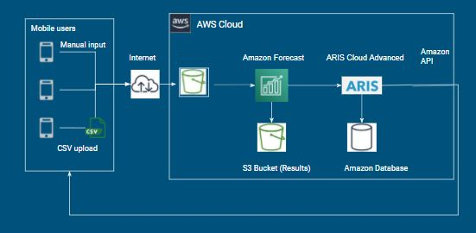
AI models used to optimize supply and demand
I dont think we need this anymore (tech execution is fine) - sandra

Slide 15
Hospital severely impacted by the breakdown of the industry supply chain
64%
15x
Normal prices
9%
of COVID cases
of survey
respondents admitted to hoarding supplies¹
Surge in demand, has lead NYC to pay above market prices²
In Italy, 9% of COVID cases are healthcare workers, need to protect our front line³
1. Healthcare finance News, 2. Vox, 3.
Notes:
Key message: 1/ hospital supply chain broken 2/ products have become inelastic 3/ we are not doing enough to protect our front line
Key message 64% responded to hoarding
Huge price increases due to competition
We are not doing enough to protect our front line, in Italy 9% of cases are healthcare workeres

Slide 16



Our value proposition to hospitals
Better inventory planning, by leveraging AI models for prediction
Reduce costs of inventory by better managing demand & supply
Enables most impacted hospitals to get access to critical equipment fast
Notes:
Key message: 1/ Most competitors are focused on an inventory management system 2/ we have predictive tools, can help reduce costs (optimization, economies of scale) 3/ allow access to critical equipment fast

Slide 17












List of equipment to distribute via our P2P marketplace
Phase I: Focus on consumables PPE ( Weeks 1-2)
Phase II: Focus on capital equipment (week 3 - 4)
Surgical masks
Isolation gown
Mask N95
Latex Gloves
Boot cover
OT Cap
Face shield
Plastic Apron
Hand Sanitizers
Goggles
Stethoscope
Physiological Monitor
Ventilator
Mobile air purifier
Notes:
Key message: 1/ launch with consumables first as they are smaller and easier to source 2/ move into more critical capital equipment
Launch consumables first as they are less critical and allows time to train the model and figure out logistics
Move into capital equipment as this is the most critical equipment

Slide 18







Platform roadmap
Phase II: Long term vision
Inventory forecast platform with P2P & B2B marketplace; Domestic and Cross-border
Hospitals
Bank (invoice financing)
Phase I: During COVID 19
Inventory Forecast with P2P marketplace
Logistics Partner
Clinic
SupplyASAP
Logistics Partner
Inventory Mgmt platforms
Medical Supplies company
Charities

Slide 19
We enables two transaction types
Direct sale of goods between P2P
Product credits between P2P
Equipment (t+3)
Equipment (t+3)
Hospital A
Hospital B
Hospital A
Hospital B
Data
SupplyASAP
Data
Data
SupplyASAP
Data
Model determines best market price & recommends quantity to purchase
System keeps tracks of items delivered and received for clearance
Payment
(t+1)
Supplier
Delivery
(t+12)
PO
(t+1)
Notes:
Key messages: 1/ pure exchange in financial terms 2/ offer goods in exchange for goods in the future

Slide 20
Other slides ideas / not to share

Slide 21
64%
Impact slide Option 2
of respondents of a 2018 survey respondents admitted to hoarding supplies
Source: https://www.healthcarefinancenews.com/news/medical-supply-shortage-64-surgical-staff-hoard-waste-or-overuse

Slide 22
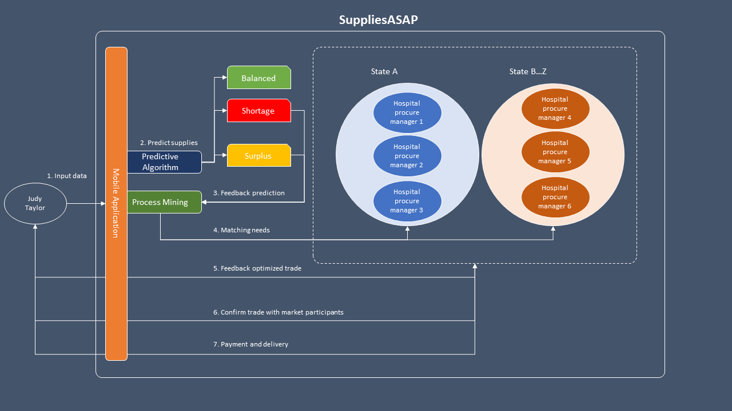
Solution Diagram

